Slide 1
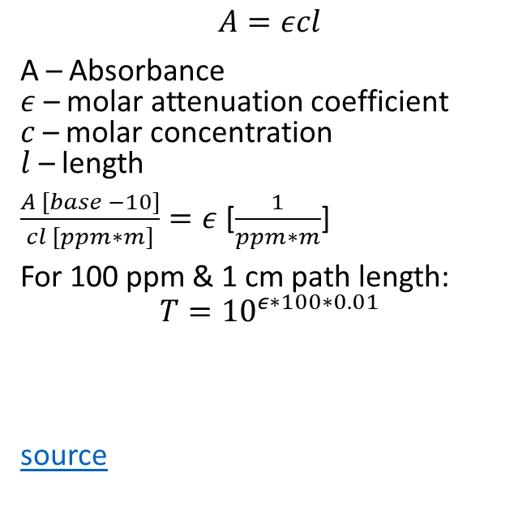
$$A=εcl$$
A – Absorbance $ε$ – molar attenuation coefficient $c$ – molar concentration $l$ – length
$\frac{A [base −10]}{cl [ppm∗m]}=ε$ [$\frac{1}{ppm∗m}$]
For 100 ppm & 1 cm path length:
$$T={10}^{ε∗100∗0.01}$$
source

